Slide 1


IAMFC Conference June 2026 · Ho Chi Minh City
Why Group Therapy?
The case for group work in Vietnam
Tran Ngoc Hieu
Clinical Psychologist · Vietnam Institute of Psychology
Chief Clinical Officer · psylab.ai
Cand.Psychol., University of Bergen, Norway
01 / 18
Notes:
Thanks to all of you for coming here today.
My name is Tran Ngoc Hieu. I am a licensed clinical psychologist currently working at Vietnam Institute of Psychology here in Ho Chi Minh City. I have previously worked in inpatient hospitals, outpatient hospitals and in private practice in Norway.
I am here to present a topic that is dear to me, group therapy, and that I think share a lot of theoretical concepts in the field of marriage and family counseling.

Slide 2
Opening
What is group therapy?
A form of therapy in which a small number of people meet under a trained therapist to help themselves and one another, in a safe, cohesive space for personal and relational concerns (The American Group Psychotherapy Association - AGPA)
Will the client benefit from group therapy?
1-3 assessment interviews to understand level of motivation and personality structure.
02 / 18
Notes:
To show you exactly what I mean, let's look at the core of what we’re actually doing when we bring people together into a room. Let’s start with a definition of group therapy.
The American Group Psychotherapy Association defines group therapy as a form of therapy in which a small number of people meet to help themselves and one another in a safe, cohesive space for personal and relational concerns.
Groups that I run usually have 8 members, with one or two therapists and a group session usually runs for 1 ½ hours. What is significant but also different about group therapy from individual therapy is the fact that you also work on your skills of being a compassionate/caring person, and not only being the one receiving care.
I also want to emphasize something important about the nature of group therapy. Underlying the assumption of various group therapy approaches is the etiology of suffering, symptoms or difficulties. For a group therapist mental health issues are at its core are relational, but also that the “prescription” is relational. We will come back to this important point later.

Slide 3
Part 1 · Evidence
Evidence / Does it work?
27,000+
Equivalent
8
Outcomes to individual counseling
across depression, anxiety, trauma,
and relational difficulties
Clients served per session
by a single counselor —
Patients across 30 years
of meta-analytic research
04 / 18
Notes:
Let us first address the matter of clinical efficacy, which is well-established in the literature. Meta-analysis of over twenty-seven thousand patients across thirty years confirms that group interventions yield outcomes equivalent to individual therapy for depression, anxiety, trauma, and relational distress.
To me the equivalence is very interesting. If a group of relative strangers can achieve therapeutic outcomes on par with the trained therapist, what is it about the group that is effective? We will be able to take a closer look at this later on.
While the concern that group members receive a fragmented distribution of attention is understandable, it relies on a misunderstanding of the mechanism. Other participants do not dilute the treatment; they constitute the treatment. This is backed by a lot of research showing that Cohesion—the bond between members—is the single strongest predictor of therapeutic success. Ultimately, this is identical to the therapeutic alliance central to work in individual therapy, expanded to the entire group.

Slide 4
Part 2 · Mechanism
Mechanism / How does it work?
The therapeutic action happens between members — in the friction, recognition, and repair that unfold in real time.
Universality
Interpersonal learning
05 / 18
Notes:
In group therapy, we don't treat the system; let each individual within the group “play out” the family dynamics. This allows the members to engage with the complexity of their relational dynamics in the here-and-now.
Interpersonal learning is the fact that ' members’ characteristic relational patterns are enacted in real-time, rendering them visible and workable, but that they can also learn from other members' ways of dealing with their relationships within the group and outside of the group.
E.g. anxious and fear of being criticised and judged.

Slide 5
Part 2 · Theory & Mechanism
Tuckman: the group develops
Groups do not begin in full working order. They pass through predictable developmental phases — each with its own emotional challenges and its own therapeutic challenges.
Forming
Storming
Norming
Performing
Adjourning
06 / 18
Notes:
We have discussed a few fundamental mechanisms—universality and interpersonal learning, that drive therapeutic change. But these mechanisms do not exist in a vacuum. To effectively facilitate those changes, we need to understand the group's natural lifecycle. A group is not a static environment; it moves through predictable phases at a macrolevel, but will also dynamically shift between different phases at a microlevel, especially in periods of change.
Let’s start at the beginning: Forming. Think of this as the "first date" of a group.
When a group first comes together, people are generally on their best behavior. Members are polite and try their best to keep their appearances. Group members are quietly trying to figure out where they fit in, who is who, and what the ultimate goals of the group. The primary focus here is simply orientation.
Now, if you are the facilitator during the Forming stage, your role needs to be Directive. Because the group is sailing in unfamiliar waters, they rely heavily on you for guidance. This is the time to step up, provide direction, define roles, and possible ways to go forward as a group.
Storming
But as we all know, the honeymoon phase doesn't last forever. That brings us to Stage 2: Storming.
This is the most volatile and critical stage of a group's development. The initial politeness wears off, and reality sets in. This is where you see clashes over working styles, personalities, and responsibilities. Members will start to challenge boundaries, question authority, and express frustration if things aren't moving fast enough. The focus shifts entirely to managing conflict and navigating differences.
As a group facilitator, the role transitions from being directive to mediating. Your job isn't to suppress the conflict or pretend it’s not happening. Avoidance will harm progression. Instead, you need to guide them through the friction, helping them resolve their differences constructively.
Norming
If a group is able to successfully navigate the storm, it will reach the stage of norming. This is where the group finally begins to establish a shared rhythm.
Acceptance replaces resistance. Group members start to genuinely appreciate each other’s unique strengths, resolve their differences quicker, and develop a real sense of community. This is the phase where shared values, rules, and workflows—or "norms"—are firmly established.
For a facilitator, this is where you get to breathe a little bit. Your role shifts to Facilitating. You can step back slightly, hand over the reins to the group, and allow the group to take more responsibility and make autonomous decisions.
Performing
At this point, the group has reached a state of true synergy. They operate like a well-oiled machine. You will see high productivity, intense motivation, and deep mutual trust. Group members work smoothly toward their shared and individual goals with very minimal need for intervention from the group therapist. Dissent and disagreements isn't personal anymore; it's handled healthily, and individual strengths are maximized. The focus is execution and goal achievement.
As a leader, your style here is Delegating as well.
Adjourning
Finally we have Adjourning, sometimes called the "Mourning" phase.
When the members has made significant changes to how they relate to others outside of the group, the dynamic shifts again. Members often experience a mix of pride in what they accomplished, alongside sadness or anxiety about moving on and splitting up with the group. The focus here is closure and transition.
As a leader, your final role is Recognition. It’s your job to celebrate the member’s successes, capture the lessons learned for future goals, and help everyone transition smoothly to life without the group.

Slide 6
Part 2 · Theory & Mechanism
Bion: beneath the surface
Wilfred Bion observed that groups operate on two levels simultaneously — one visible, one not.
WORK GROUP
BASIC ASSUMPTION GROUP
The group engaged with its actual task — present, rational, cooperative. Members think, listen, and work toward shared goals.
The group captured by unconscious collective defenses. Three basic assumption states pull the group away from its task:
Dependency
Fight-flight
Pairing
07 / 18
Notes:
Tuckman show us how the group changes over time. Bion takes you underneath it. His observation was that a group is always running on two levels at once. On the surface, the work group — people being reasonable, listening, getting on with the task. But beneath it, whenever anxiety rises, the group slips into what he called a basic assumption: a shared, unspoken fantasy about why it's really together.
A family, too, is more than the people in it. It has a collective life, a way of organizing itself under stress that no single member chose and none can quite explain.
Bion proposed three basic assumption states.The first is dependency — the group acts as if it can't survive without someone to hold it: a leader, an expert, a rescuer. You can see this in the dynamic of a family that falls apart without the one over-functioning parent or the family that arrives at our consulting office waiting helplessly for you to fix them.
The second is fight-or-flight — which is when the group can only be held together by having an enemy to fight or a danger to flee. The family that's united only against the school, the in-laws, the bad influence.
The third is pairing — the group pins its hope on a couple, or a coming event, that will deliver it. When the baby comes, when he gets the job, when she marries — then everything will be fine. Hope, used as a way of never doing the work today.
Every group and every family lives somewhere between real work and basic assumptions, all the time. The skill — for the group conductor is to notice which one the room has slipped into, and to name it.
There's a gift in this. When one member is 'being difficult,' Bion lets you ask a different question — not what's wrong with them, but what is the group using them to say? The difficult member is often just the one voicing the group's basic assumption out loud.

Slide 7
Part 2 · Theory & Mechanism
Foulkes: the group matrix
S.H. Foulkes, the founder of group analysis, proposed that the group is not merely a setting for therapy — it is the therapeutic medium itself.
The group matrix
The group as agent of change
The hall of mirrors
08 / 18
Notes:
There are three ideas of his that are important to know about. The first is the matrix — the group as a web of communication and relationship, mostly out of awareness, through which meaning and feelings travel. The individual, in his image, is a nodal point in that web, the way a single neuron only means something inside a network. You already know the most important matrix there is: it's the family. We are each born into a web of relationships that exists before us and shapes who we become. The node doesn't precede the network. The matrix comes first.
The second is the group as a whole as an agent of change. If the matrix is what heals, then the therapist isn't the healer — the whole group is. Foulkes refused the word 'leader.' He called the therapist the conductor — like an orchestra conductor, who plays no instrument and treats no single player, but tends the whole orchestra. You're not there to fix one person in the room. You're there to change what happens between them.
The third is the hall of mirrors. In a group, each member meets, in the others, the parts of themselves they can't yet see or own — and in that reflection those parts become available to be reclaimed. Any family counselor knows this room: the father who can't bear his own dependency, so he sees it, and attacks it, in his son. The group makes those mirrors visible, and workable, on purpose.

Slide 8
Part 2 · Theory & Mechanism
Horwitz: projective identification in the group
Leonard Horwitz described how a group unconsciously deposits its disowned feelings into particular members, who then carry them on the group’s behalf. Three dynamics recur:
Role suction
The spokesperson
Scapegoating
10 / 18
Notes:
His subject is projective identification — and in a group it works like this. The group has feelings it can't tolerate: rage, neediness, weakness, shame. Rather than hold them, it deposits them into a member. And the part that makes this more than blame — the member takes them up, which is called projective identification. They begin, genuinely, to feel and act out what the group couldn't bear. The group gets to stay calm and competent, because someone else is now carrying its disowned and unaccepted experience. The feeling didn't disappear. It got concentrated in one person.
The acting-out teenager, the depressed mother, the 'problem' child the family brings you to fix. The family's unbearable feeling, lodged in one member, who is then presented as the one who's sick. Horwitz is describing the mechanism in the group. Same evacuation, same recruited carrier, same illusion that the trouble lives in one person.
He traced three forms of projective identification in groups. The first is role suction — the group's pull on a member to take up a needed role. Someone has to be the angry one, the fragile one, the responsible one, the clown. The role is drawn out of them by what the group needs, often the person whose history makes them most willing to take it.
The second is — the spokesperson. One member voices a feeling that actually belongs to everyone. They seem to be speaking for themselves; in fact they're speaking for the room. The one who finally says 'I don't think this is working' — and you can feel the silent agreement behind them. Useful, when you can hear it as the group's voice and not just one person's complaint.
The third is the dangerous one — scapegoating. This is role suction turned dangerous. The group deposits its intolerable feeling into one member, and then blames, isolates, or expels them. And it works — for the group. Getting rid of that member preserves the group's image of itself as good, calm, united. It buys the group's comfort at one member's expense. Every family counselor has met the family organized around a scapegoat — peaceful, functional, intact, as long as one person agrees to be the problem.
Scapegoating is what happens when no one interrupts the split — when a disowned position collapses onto a single person. 'Anyone else?' is the antidote. You break the projection by asking the room to take its feeling back: who else is angry, who else wants to quit, who else feels like the weak one here? The moment the feeling is shared, the scapegoat is released — and so is the identified patient.
And a word of caution, because this is the most dangerous moment in any group. When a group scapegoats, the conductor's job is not to rescue the scapegoat — that just confirms they're fragile and special. It's to widen the lens: to ask the room what it's putting into this one person. You protect the member by making the projection visible, not by defending them.

Slide 9
Part 2 · Theory & Mechanism
Agazarian: Systems-Centered Therapy
Yvonne Agazarian's SCT treats the group as a living human system. The goal is not to treat individuals — it is to develop the system itself, so that the system can heal its members.
Functional subgrouping
"Anyone else?"
09 / 18
Notes:
I also believe Systems-Centered Therapy by Agazarian has an important place in group therapy. SCT and family therapy share a parent in general systems theory, and they reach the same conclusion: you don't treat the members, you develop the system or the group, and the system heals its members.
The question is how - through functional subgrouping. The problem this solves is that when a difference shows up in a group, or a family, the natural thing is to split. Two camps form, each sure of its own righteousness, and the system tries to settle the difference by deciding who wins. But the losing position doesn't disappear when it loses. It gets located in a person — the one who voiced it — and that person gets pushed out. That is how a group manufactures a scapegoat. It's how a family manufactures an identified patient.
Subgrouping interrupts that. Instead of asking who's right, the conductor asks members to join around what they share — so that every side of a difference is carried by more than one person. No one is left holding a position alone. You're not resolving the conflict; you're making sure it can't collapse onto a single member.
And it operationalizes into two words. The signature SCT intervention is simply: 'Anyone else?' A member says something raw or new — and instead of turning to treat them one-to-one while the room watches, you ask, 'Does anyone else feel something like that?' Spreads the feeling among the members. It stops being one person's experience and becomes the group's. One example: when the teenager in a group says nobody in the family listens, the systemic move isn't to fix the teenager — it's to ask who else feels unheard.

Slide 10

The trap of the individual lens
Đêm tối rực rỡ! (The Brilliant Darkness), dir. Aaron Toronto, 2022
03 / 18
Notes:
It’s one thing to talk about the 'relational' nature of suffering in the abstract, but we see it play out in our therapy rooms every single day. To really bring this point home, I want to focus on an example from a film, The Brilliant Darkness, which captures exactly this dynamic—a family where the 'illness' isn't just in one person, but in the entire web of relationships.
The movie is about a southern Vietnamese funeral for the recently deceased grandfather. While on the surface the funeral brings relatives and friends into their home for the celebration, underneath, tensions between the family members progressively emerge.
What the viewer learns is that the eldest daughter, is suffering from anxiety, depression, PTSD and self-harm. In other words, she is the “identified patient” of the family. One one who is “sick”. She escaped her abusive father, the aggressor, only to find an abusive husband. Over the course of the film, we learn that not only was the father abusive, he had been amassing an enormous amount of debt because of his gambling addiction. But there are many more roles in this family keeping the “sickness” within the eldest daughter. The firstborn son, which in Vietnamese culture sometimes has a privileged role, acts as the upholder of the system, in the sense that he justified the destructive patriarchal family structure. While the youngest daughter due to her externalizing behaviour of drug abuse and rebelliousness, was judged by the family as an outcast. The mother, too afraid to confront her husband for his domestic abuse, was also keeping the family dynamic in check. At one point in the movie the mother even said that “Depression is just a sickness in your head, you gotta be strong and just get over it”. So looking at the description of this family, where do you think the sickness is?

Slide 11

Part 3 · Vietnam
11 / 18
Notes:
The easy thing to say here is that Vietnam is collectivist, collectivism means belonging, belonging is what groups offer, so people group therapy will be suitable in Vietnam But this is only half of the truth.
The harder truth is that the very bonds that hold a person are the bonds that can wound them. It is the kind of system that silences differences most efficiently, that pressures its members into a false harmony, and that — when it can't tolerate its own tension — presses that tension into one member to carry alone.
So the wound, in a collectivist culture, has a particular shape. The cost of belonging is the suppression of your own voice — you keep your place in the family by not disturbing it, by absorbing rather than speaking, sometimes by becoming the one who holds the family's trouble so the family's image can survive.
So this isn't a culture that group counseling happens to suit. It's a culture whose suffering is done by a group, the family — and a group is also the opportunity to heal ones suffering. We're just changing what group used for the members of the group.
This single cloth is all one weave — the same threads run through every part of it. But the tension is not the same everywhere.
On the left, the weave is pulled tight. So tight it has bunched and knotted in on itself, until the threads no longer form a fabric at all but a dense, clenched knot. This is belonging at its most binding: cohesion that has turned into constriction. Nothing gets in, nothing gets out. What began as holding has become a grip.
On the right, the same threads runs loose. The weave opens into wide gaps; the fibers fray and drift, some trailing off into nothing. This is belonging at its most slack: so much room that the structure begins to dissolve. The threads are free — and coming apart.
And running through both are the blue threads. It passes through the suffocating knot and out into the loosening edge without changing its nature. It is the same thread in both conditions — the individual carried by the group, held too tightly here, barely held at all there.
Neither end is healthy. The knot cannot breathe; the fray cannot hold. A living group, like a living cloth, lives in the tension between them — woven closely enough to carry weight, openly enough to let each thread move. The clinical question is never whether we as humans are bound to one another, but at what tension.

Slide 12


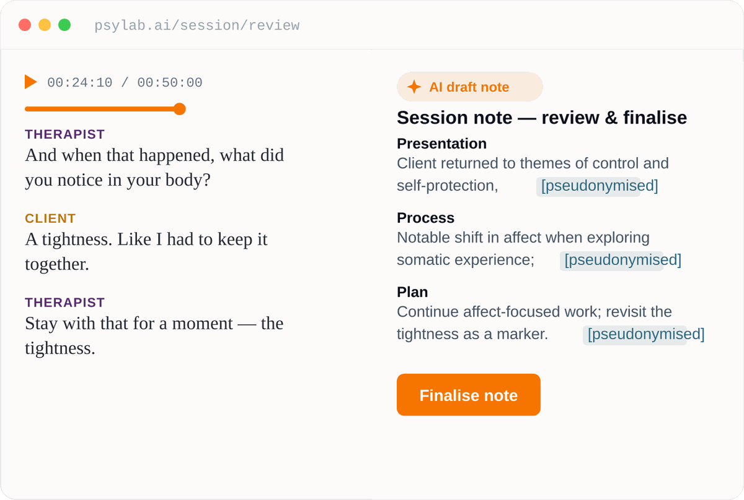
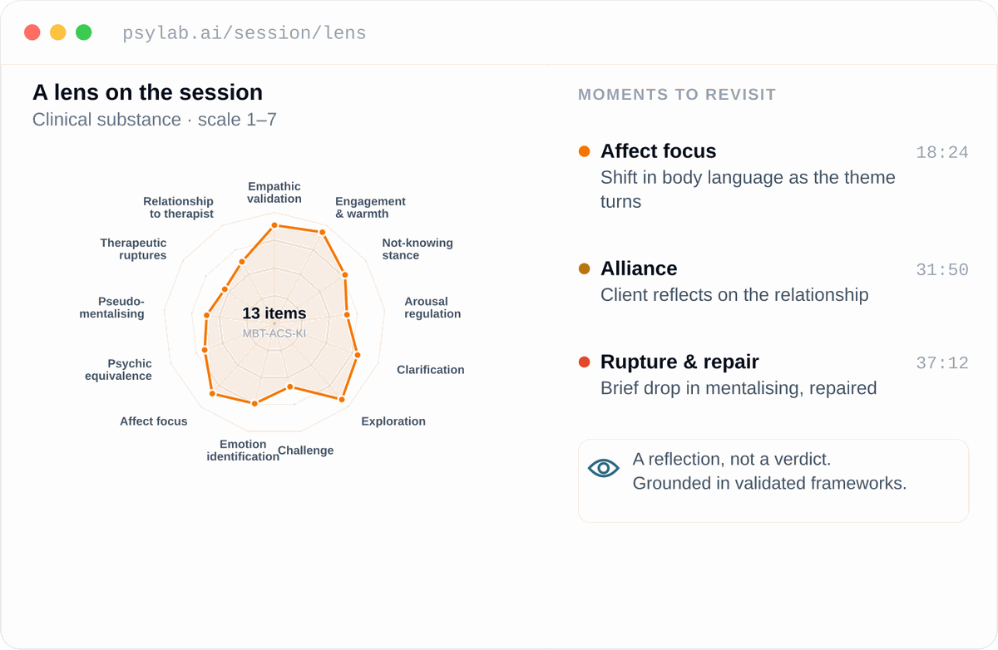
psylab.ai
FOR THERAPISTS
The objective mirror for your clinical practice.
Turn your notes into professional growth.
DOCUMENTATION
A LENS ON YOUR WORK
Your notes, written for you
A new perspective on your sessions
Notes:
As we consider the rigorous frameworks we have just explored—the group as a living system, a matrix of unconscious currents, and different group processes—we face a challenge in our field: the gap between our theoretical models and the raw reality of clinical practice. The work we do in therapy has been limited by our own memory and the fallibility of subjective reports. To truly practice at the level of our theories, we must shift our lens from the reconstructed narrative to the phenomenological truth of what actually transpired in the room. This brings me to something I am currently working on.
I am part a team developing psylab, a way for therapists and supervisors to effectively write notes and hone on the skill and practice of psychotherapy in an unprecedented way. All in the safest security system in the world.

Slide 13
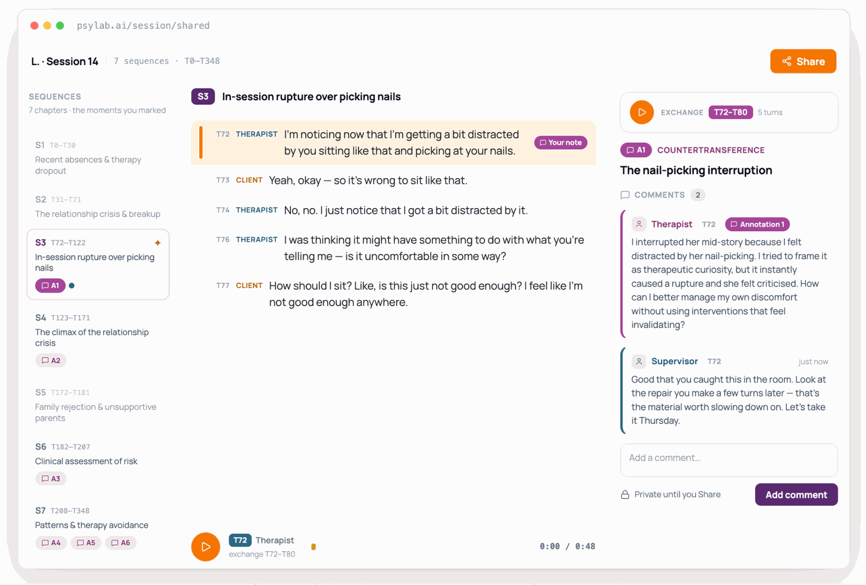
Notes:
We envision a new way for the therapist to learn from their sessions. You will be able to look at your sessions just like a musician wanting to improve on their technique by rewinding their performance to moments they want to learn and grow (peke på tidsviseren), review what happened between you and the client (vise til midten) and comment what you found difficult during that passage (vise på høyre side). This way you will be able to get the most out of your own supervision. Going from your reconstructed memory to what actually happened in the room.

Slide 14
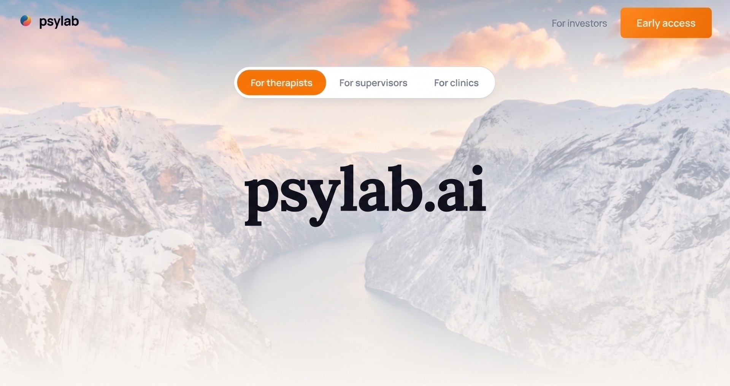

Notes:
Check our website psylab.ai or use the QR-code to get early access.

Slide 15
References
Sources
Agazarian, Y. M. (1997). Systems-centered therapy for groups. Guilford Press.
Bion, W. R. (1961). Experiences in groups and other papers. Tavistock Publications.
Burlingame, G. M., & Strauss, B. (2021). Efficacy of small group treatments: Foundation for evidence-based practice. In M. Barkham, W. Lutz, & L. G. Castonguay (Eds.), Bergin and Garfield’s handbook of psychotherapy and behavior change (7th ed., pp. 583–624). Wiley.
Foulkes, S. H. (1973). The group as matrix of the individual’s mental life. In L. R. Wolberg & E. K. Schwartz (Eds.), Group therapy 1973: An overview (pp. 211–220). Intercontinental Medical Book Corporation.
Horwitz, L. (1983). Projective identification in dyads and groups. International Journal of Group Psychotherapy, 33(3), 259–279. https://doi.org/10.1080/00207284.1983.11490877
Rosendahl, J., Alldredge, C. T., Burlingame, G. M., & Strauss, B. (2021). Recent developments in group psychotherapy research. American Journal of Psychotherapy, 74(2), 52–59. https://doi.org/10.1176/appi.psychotherapy.20200031
Tuckman, B. W. (1965). Developmental sequence in small groups. Psychological Bulletin, 63(6), 384–399. https://doi.org/10.1037/h0022100
Yalom, I. D., & Leszcz, M. (2005). The theory and practice of group psychotherapy (5th ed.). Basic Books.
14 / 18

Slide 16
Appendix
Glossary of concepts
Universality — the discovery that one's struggles are not unique; hearing others voice the same fears dissolves the isolation of shame.
Corrective recapitulation of the family group — the group comes to resemble the family of origin, so early relational patterns can be re-enacted, observed, and reworked.
Interpersonal learning and altruism — the group is a social microcosm where members receive honest feedback, practice new ways of relating, and rediscover their value by helping others.
Forming — the first phase — members orient, test boundaries, and depend on the leader for structure; anxiety is high and cohesion tentative.
Storming — conflict surfaces between members, with the leader, and with the task; working through it rather than avoiding it builds real trust.
15 / 18

Slide 17
Appendix
Glossary of concepts (cont.)
Norming — the group develops its own culture, shared norms, and trust; cohesion deepens and members begin to take risks.
Performing — the group reaches working maturity — members engage authentically and tolerate difference, so deeper work becomes possible.
Work group — the group functioning at the level of its actual task — present, rational, and cooperative toward shared goals.
Basic assumption group — the group's unconscious defensive life; under anxiety it slips into dependency, fight-flight, or pairing, moving away from its task.
The group matrix — the shared, largely unconscious web of communication and relationship through which meaning, emotion, and healing travel.
16 / 18

Slide 18
Appendix
Glossary of concepts (cont.)
The group as agent of change — the group itself heals; the conductor's role is to tend the matrix rather than treat members one by one.
The hall of mirrors — each member encounters in others the disowned or hidden parts of themselves, allowing those parts to be confronted and reclaimed.
Functional subgrouping — members join around similarities rather than splitting into opposing camps, containing conflict and preventing scapegoating.
“Anyone else?” — the signature systems-centered intervention — affect is redistributed across the group so no one member becomes its sole container.
Defense modification hierarchy — the deliberate sequence of weakening defenses — from tension and anxiety, through conflict, toward authentic contact — at the system's edge.
17 / 18

Slide 19
Appendix
Glossary of concepts (cont.)
Role suction — the group’s pull on a member to take up a needed role — the angry one, the vulnerable one — drawn out of them by the group’s unspoken needs.
The spokesperson — one member voices a feeling or position that belongs to the whole group, appearing to speak for themselves while in fact speaking for everyone.
Scapegoating — the group deposits its disowned, intolerable feelings in one member, whose blame or expulsion preserves the group’s image of itself at that member’s expense.
18 / 18

